Slide 1
Discrete Optimization
Apr. 18
Group members

Slide 2
Framework
A general introduction to discrete optimization
Topic 2 ?
Topic 3 ?
Topic 4 (solve mixed integer optimization using ga toolbox)

Slide 3
Definition of discrete optimization
Discrete optimization is a branch of optimization in applied mathematics and computer science, as opposed to continuous optimization, the variables used in the mathematical program (or some of them) are restricted to assume only discrete values, such as the integers
Two notable branches of discrete optimization are:
combinatorial optimization, which refers to problems on graphs, matroids and other discrete structures
integer programming

Slide 4
Definition of discrete optimization
combinatorial optimization is a topic that consists of finding an optimal object from a finite set of objects
An integer programming problem is a mathematical optimization in which some or all of the variables are restricted to be integers

Slide 5
Some examples in discrete optimization
Integer linear programming
Set cover problem
Knapsack problem
Graph theory
Minimum spanning tree
Vertex cover problem
Traveling salesman problem (Hamiltonian circuit)
Shortest path problem
Scheduling problem
Maximum flow problem

Slide 6
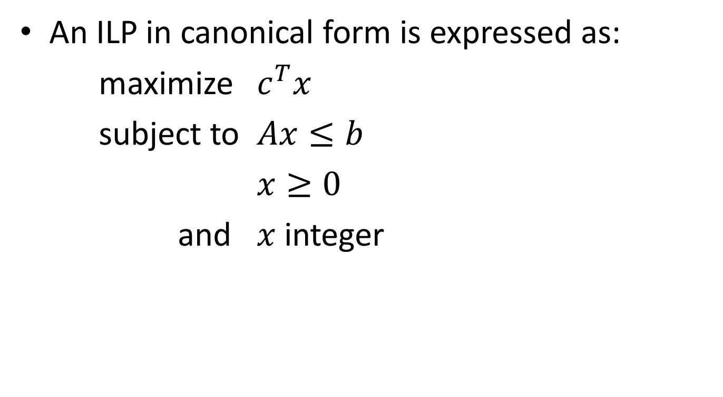
Integer linear programming (NP-hard)
An ILP in canonical form is expressed as:
maximize $c^{T}x$
subject to $Ax≤b$
$x≥0$
and $x$ integer

Slide 7
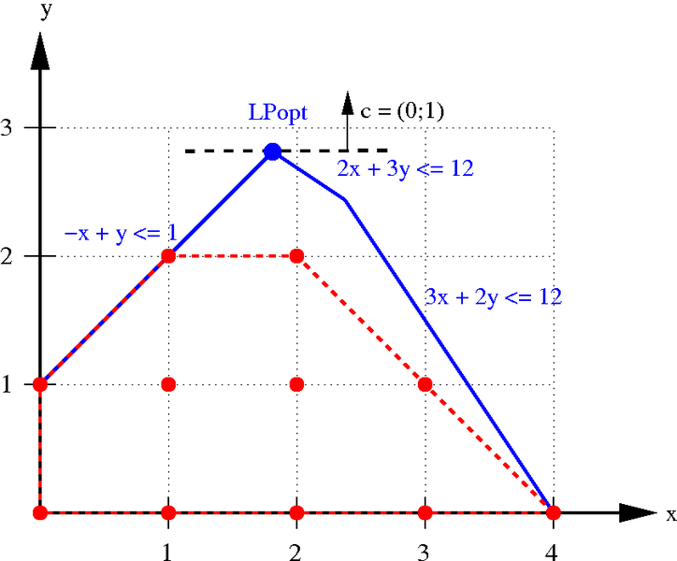
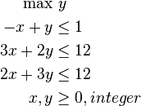
Integer linear programming (NP-hard)
An example:

Slide 8
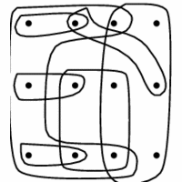
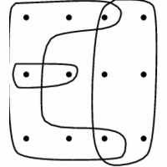
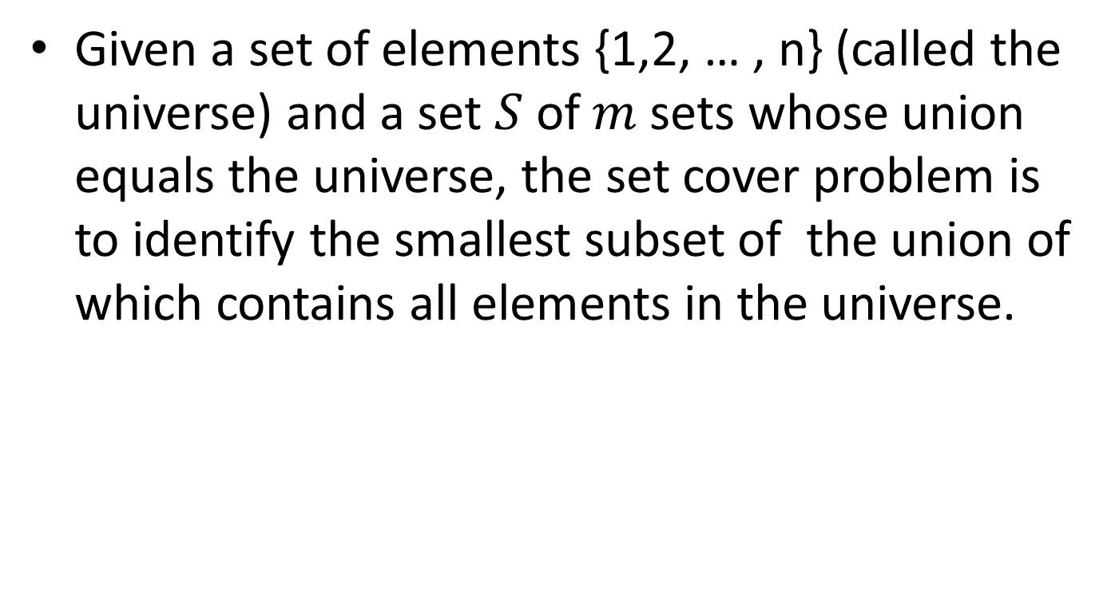
Set cover problems (NP-hard)
Given a set of elements $\text{\{1,2, … , }\text{n}\text{\}}$ (called the universe) and a set $S$ of $m$ sets whose union equals the universe, the set cover problem is to identify the smallest subset of the union of which contains all elements in the universe.

Slide 9
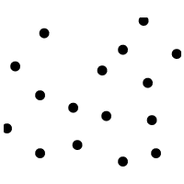
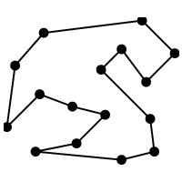
Traveling salesman problem (NP-hard)
The travelling salesman problem (TSP) asks the following question: given a list of cities and the distances between each pair of cities, what is the shortest possible route that visits each city exactly once and returns to the origin city?

Slide 10
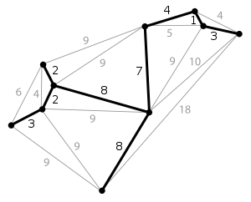
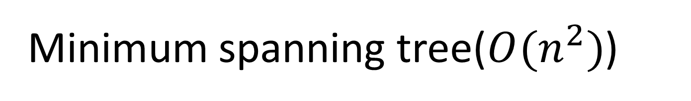
Minimum spanning tree($O(n^{2})$)
A minimum spanning tree (MST) is then a spanning tree with weight less than or equal to the weight of every other spanning tree
Can be solved by Kruskal's algorithm(greedy Alg.)

Slide 11
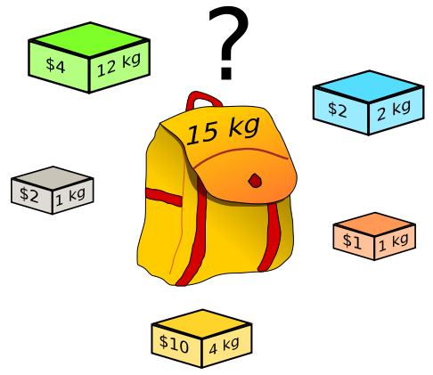
Knapsack problems (NP-hard)
Given a set of items, each with a weight and a value, determine the number of each item to include in a collection so that the total weight is less than or equal to a given limit and the total value is as large as possible.
Backtracking Algorithm

Slide 12
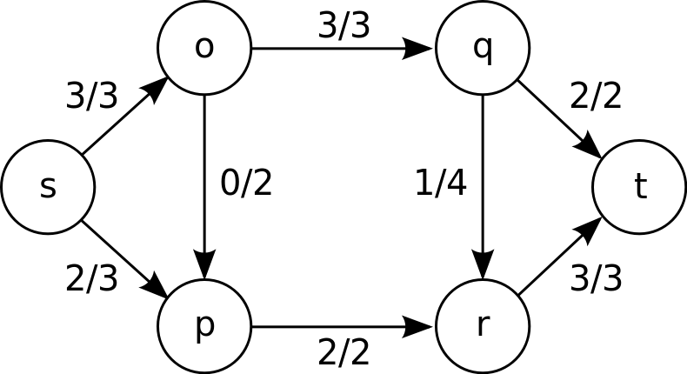
maximum flow problem (NP-hard)
Maximum flow problem is to find a feasible flow through a single-source, single-sink flow network that is maximum
Max-flow min-cut theorem

Slide 13
Let’s discuss more on Tuesday …

Slide 14
Topic 2

Slide 16
Topic 3

Slide 18
Topic 4

Slide 20
Reference
wikipedia.org
http://www.cs.sunysb.edu/~algorith/implement/syslo/implement.shtml

